Slide 1
Chapter Six
Business Markets and Business Buying Behavior

Slide 2
Business Markets and Business Buying Behavior
Topic Outline
Define the business market and explain how business markets differ from consumer markets
Identify the major factors that influence business buyer behavior
List and define the steps in the business buying-decision process
Compare the institutional and government markets and explain how institutional and government buyers make their buying decisions

Slide 3
Business Markets
Business buyer behavior refers to the buying behavior of the organizations that buy goods and services for use in production of other products and services that are sold, rented, or supplied to others. Also included are retailing and wholesaling firms that acquire goods to resell or rent to others for profit.
Business buying process is the process where business buyers determine which products and services are needed to purchase, and then find, evaluate, and choose among alternative brands

Slide 4
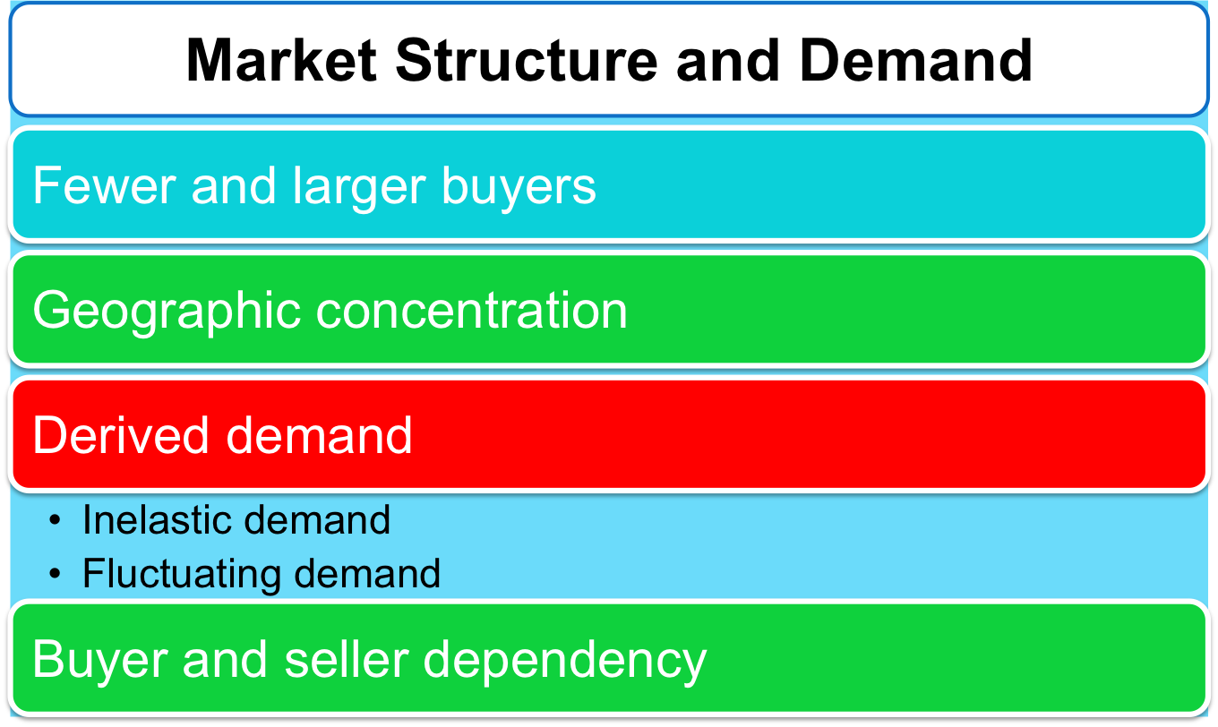

Business Markets

Slide 5
Business Markets
More decision participants
More professional purchasing effort

Slide 6
Business Markets
Types of Decisions and the Decision-Making Process
Supplier development is the systematic development of networks of supplier-partners to ensure an appropriate and dependable supply of products and materials that they will use in making their own products or resell

Slide 7
Business Buyer Behavior
Major Types of Buying Situations
Straight rebuy is a routine purchase decision such as reorder without any modification
Modified rebuy is a purchase decision that requires some research where the buyer wants to modify the product specification, price, terms, or suppliers
New task is a purchase decision that requires thorough research such as a new product

Slide 8
Business Buyer Behavior
Major Types of Buying Situations
Systems selling involves the purchase of a packaged solution from a single seller
Two-step process of selling:
  Interlocking products
  System of production, inventory control, distribution, and other services to meet the buyer’s need for a smooth-running operation

Slide 9
Business Buyer Behavior
Participants in the Business Buying Process
Buying center is all of the individuals and units that participate in the business decision-making process
  Users
  Influencers
  Buyers
  Deciders
  Gatekeepers

Slide 10
Business Buyer Behavior
Participants in the Business Buying Process
Buying center provides a major challenge
Who participates in the process
  Their relative authority
  What evaluation criteria each participant uses
  Informal participants

Slide 11
Business Buyer Behavior
Participants in the Business Buying Process
Users are those that will use the product or service
Influencers help define specifications and provide information for evaluating alternatives
Buyers have formal authority to select the supplier and arrange terms of purchase
Deciders have formal or informal power to select and approve final suppliers
Gatekeepers control the flow of information

Slide 12
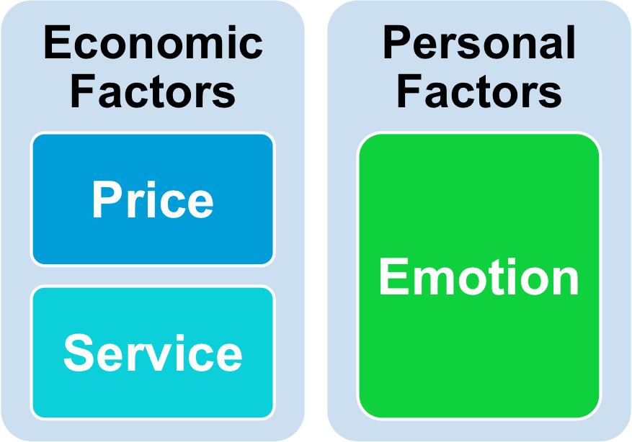
Business Buyer Behavior
Major Influences on Business Buyers

Slide 13
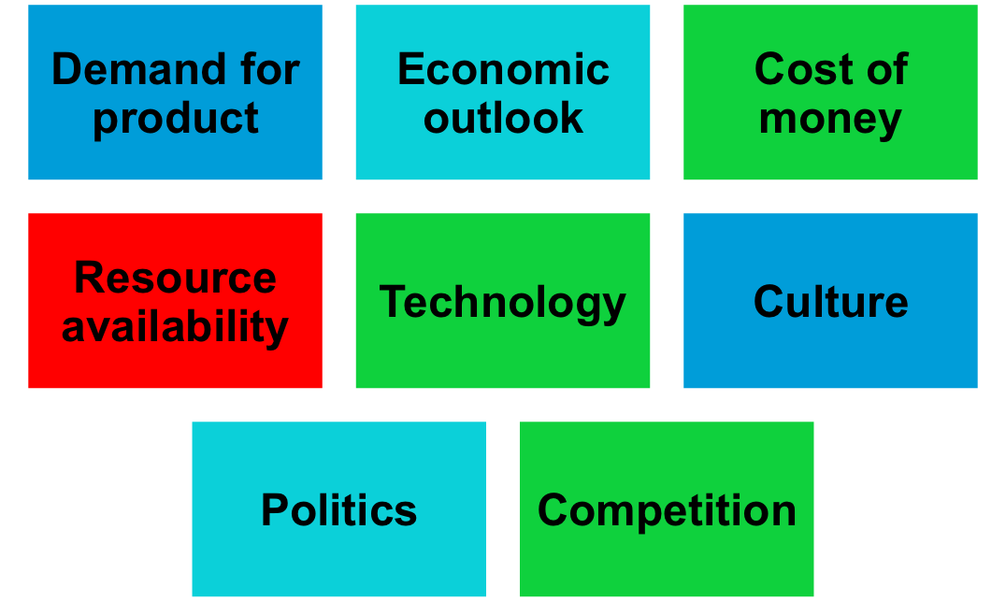
Business Buyer Behavior
Major Influences on Business Buyers
Environmental Factors

Slide 14
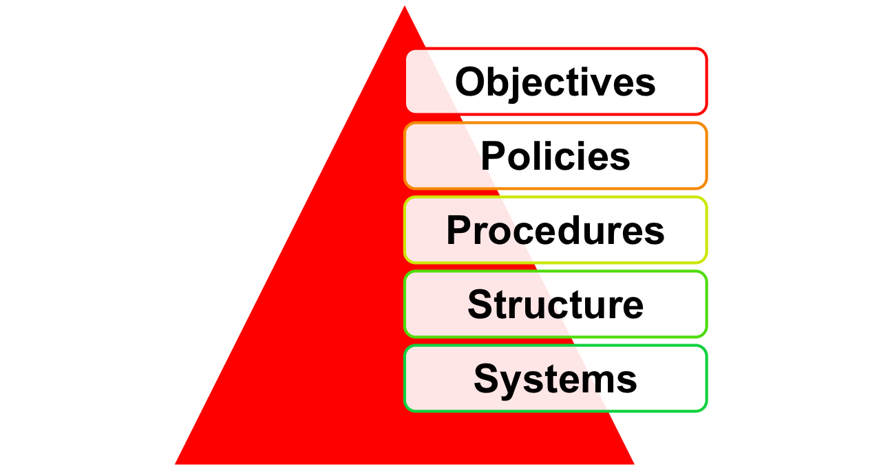
Business Buyer Behavior
Major Influences on Business Buyers Organizational Factors

Slide 15
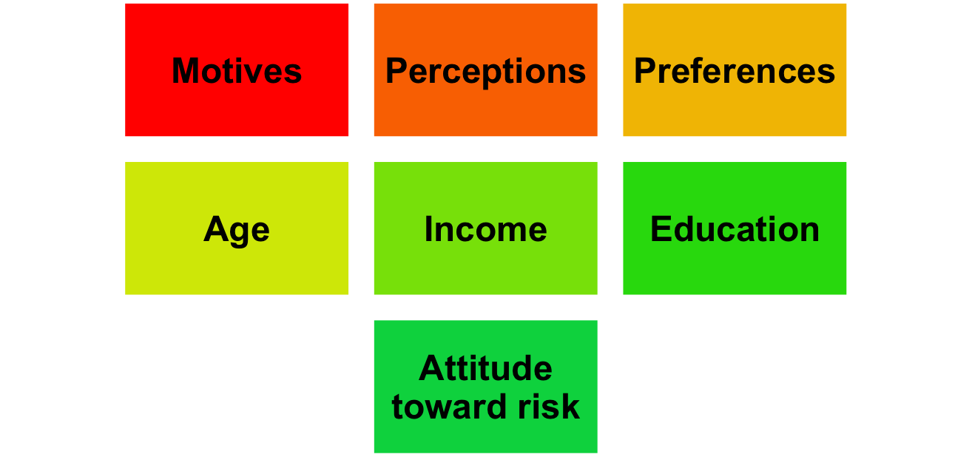
Business Buyer Behavior
Major Influences on Business Buyers
Interpersonal Factors

Slide 16
Business Buyer Behavior
The Buying Process
Problem recognition occurs when someone in the company recognizes a problem or need
Internal stimuli
  Need for new product or production equipment
External stimuli
  Idea from a trade show or advertising

Slide 17
Business Buyer Behavior
The Buying Process
General need description describes the characteristics and quantity of the needed item
Product specification describes the technical criteria
Value analysis is an approach to cost reduction where components are studied to determine if they can be redesigned, standardized, or made with less costly methods of production

Slide 18
Business Buyer Behavior
The Buying Process
Supplier search involves compiling a list of qualified suppliers
Proposal solicitation is the process of requesting proposals from qualified suppliers

Slide 19
Business Buyer Behavior
The Buying Process
Supplier selection is the process when the buying center creates a list of desired supplier attributes and negotiates with preferred suppliers for favorable terms and conditions
Order-routine specifications is the final order with the chosen supplier and lists all of the specifications and terms of the purchase

Slide 20
Business Buyer Behavior
The Buying Process
Performance review involves a critique of supplier performance to the purchase terms

Slide 21
Business Buyer Behavior
E-Procurement
Online purchasing
Company-buying sites
Extranets

Slide 22
Business Buyer Behavior
E-Procurement
Advantages
  Access to new suppliers
  Lowers costs
  Speeds order processing and delivery
  Shares information
  Sales
  Service and support
Disadvantages
  Can erode relationships as buyers search for new suppliers
  Security

Slide 23
Institutional and Government Markets
Institutional markets consist of hospitals, nursing homes, and prisons that provide goods and services to people in their care
Characteristics
  Low budgets
  “Captive” audience

Slide 24
Institutional and Government Markets
Government markets tend to favor domestic suppliers and require suppliers to submit bids and normally award to the lowest bidder
Carefully monitored
Affected by similar environmental factors
Good credit
Non-economic factors
Minority suppliers
Depressed suppliers
Small businesses

